Slide 1
MGT 207
Quality Management and Statistical Process Control

Slide 2
Natural Manufacturing Variations

Slide 3
All Processes Have Some Variation…
But There Is Typical Variation and Atypical Variation
For example, the time taken to rate an insurance policy …
What would you think if the time to rate a particular policy took 40 minutes
Time
20 min
Application number
Notes:
All operations involve some sort of processes, whether it’s a production process to manufacture tangible goods, or it’s a service process to provide intangible service. One you have process, you’ll face variations.

Slide 4
Process is In-Control if Measurements Fall Within the Typical Range
This process is staying in control
Time
20 min
Application number
In-control does not necessarily mean high quality, it just means the process is behaving as you expect it to behave

Slide 5
A Change In Measurements Indicates Process May Be Out-of-Control
A significant change indicates that the process is no longer behaving as you expect it to behave
Time
20 min
Application number
Notes:
What is significant change and what is not – this all seems too subjective. Yes, indeed so far we haven’t been able to what is an atypical change in a process, that’s where we need statistical techniques – next, I’m going to introduce a method that will allow us to objectively decide what is an atypical change, in other words, allow us to tell the difference between acceptable and inacceptable variation.

Slide 6
Quality Testing by Sampling
Goal: to see if there is …
  A shift in process mean
  An increase in process variation
A sample is a set of measurements
For example
  Sample frequency = every 5 products
  Sample size n=4
Inspection
Sample 2
Sample 1

Slide 7
Some Examples of Sample Data…
Sample (Inspection) | Measurement |  |  |  | Sample Mean | Range (max-min)
 | 1 | 2 | 3 | 4
1 | 97.06 | 97.32 | 100.19 | 101.02 | 98.90 | 3.96
2 | 97.68 | 100.05 | 97.80 | 97.85 | 98.34 | 2.37
3 | 98.76 | 98.22 | 100.72 | 103.11 | 100.20 | 4.89
4 | 101.34 | 100.00 | 103.19 | 105.79 | 102.58 | 5.79
5 | 102.78 | 105.28 | 105.02 | 97.96 | 102.76 | 7.32
6 | 104.23 | 104.57 | 97.50 | 100.39 | 101.67 | 7.07
Notes:
Vertically list all samples
Horizontally list all measurement in a particular sample.
Tabulate the means for each sample
Tabulate the ranges for each sample

Slide 8
Visualizing the Data Can Be Helpful
A plot of sample means
Sample Mean
Sample
Notes:
This is a scatter plot

Slide 9
Let’s Look at the Next Sample Mean
Say Sample 7 comes in with a mean of 85
Sample Mean
Sample
How might you decide if 85 is atypical for this process?

Slide 10
One Approach Is to Specify Limits on What Is Typical
Anything outside the limits is considered abnormal
Think of the Sample Means being Normally Distributed
Notes:
Central limit theorem: sample average is normally distributed around the true average or population average and the variability depends on sample size.

Slide 11
But What Are the Right Limits ?
Wide or Narrow?
Pros and Cons of Wide or Narrow
Wide ?
Narrow
Pro:
Con:
Wide
Pro:
Con:
Narrow ?
Notes:
Type I vs Type II error:
When limits are too narrow, you may have false alarms too often, i.e., making too many type I errors.
When limits are too wide, you may have overlooked problems, making type II errors
Link to appraisal costs vs. external failure costs.

Slide 12
Often the Limits Are Set As Mean +/- 3 Standard Deviation
Anything outside the limits is considered atypical
UCL: upper control limit
3 x Standard deviation
Center Line = Mean
3 x Standard deviation
LCL: lower control limit
Notes:
Three Sigma quality level translates to a process yield of 99.73% yield.

Slide 13
How Many Defects Per Million?
Mathematical Representation:
Calculate Z-Scores:
For +3 Standard Deviations: =NORM.S.DIST(3,TRUE)
For -3 Standard Deviations: =NORM.S.DIST(-3,TRUE)
Calculate Probabilities Outside Limits:
=1 - (Z-Score for +3) + (Z-Score for -3)=1-0.9986+0.001349
Convert to the Number of Defects per Million Units Produced:
= 1E06*(1-0.9986+0.001349)=2,700.

Slide 14
What mean and standard deviation should we use ?
Sample Means’ Mean
The mean of the sample means
Number of samples
Sample mean for the i^{th} sample
Sample Means’ Standard Deviation
The standard deviation of the sample means
  Can be estimated as the standard deviation of an individual measurement (i.e. the process standard deviation) divided by square root of n, the sample size
Process standard deviation
Sample size

Slide 15
Calculating Process Standard Deviation
Process Standard Deviation
The average value (mean) of the sample ranges
A constant that can be found in tables

Slide 16
Bringing It All Together
UCL: upper control limit
3 x Standard deviation
Mean of the sample ranges
Mean of the sample means
A constant that can be found in tables
Mean
3 x Standard deviation
LCL: lower control limit
Control Limits = Mean of Sample Means +/- Constant x Mean of Sample Ranges

Slide 17
Table for A₂ constants
Sample size is the number of measurement in each sample and NOT the number of samples

Slide 18
Calculate the Center Line, UCL and LCL for the following set of data
Sample | Measurement |  |  |  |  | Mean | Range
 | 1 | 2 | 3 | 4 | 5
1 | 49.59 | 53.94 | 47.11 | 60.58 | 43.48 | 50.94 | 17.10
2 | 60.41 | 48.90 | 29.19 | 58.87 | 39.80 | 47.44 | 31.22
3 | 65.89 | 56.96 | 44.15 | 60.76 | 50.39 | 55.63 | 21.74
4 | 48.48 | 51.02 | 57.36 | 45.54 | 63.11 | 53.10 | 17.56
5 | 49.10 | 40.69 | 42.10 | 29.26 | 46.40 | 41.51 | 19.84
6 | 42.76 | 35.11 | 47.66 | 46.78 | 44.93

Slide 19
Center Line, UCL and LCL
Center Line
UCL
LCL

Slide 20
Consider the Following Samples
Is the Process In-Control?
Sample | Measurement |  |  |  |  | Mean
 | 1 | 2 | 3 | 4 | 5
101 | 36.62 | 50.01 | 44.39 | 35.84 | 50.41 | 43.45
102 | 42.91 | 34.72 | 54.82 | 51.67 | 56.01 | 48.03
103 | 57.50 | 49.69 | 69.49 | 43.18 | 51.50 | 54.27
104 | 58.36 | 53.28 | 55.59 | 59.06 | 41.70 | 53.60
105 | 30.22 | 16.00 | 51.87 | 44.67 | 94.27 | 47.40
106 | 2.92 | 28.45 | 76.67 | 66.05 | 29.04 | 40.63
All means fall within the control limits so the process mean has not shifted

Slide 21
Plotting the Sample Means
Sample means all fall within control limits
Sample Mean
UCL
Centerline
LCL
Sample
Notes:
Talk about how to draw UCL and LCL, center line using excel.

Slide 22
X-bar Charts Capture Shift in Means But Not Shift in Variability
X-bar would capture the following process shift
X-bar would not capture the following process shift
Original process
Process undergoes a shift in the mean
Original process
Process mean stays the same but process becomes more variable
The shift would be noticed as the sample means would start to fall outside the control limits
The shift would NOT be noticed as the sample means would still fall within the control limits

Slide 23
Range charts
Measuring Shifts in Variability

Slide 24
Range Charts (R-Charts) Are Used to Capture Shifts in Variability
Anything outside the limits is considered atypical
How Do We Set the Control Limits
1
Calculate the Mean Range
UCL: upper control limit
2
Calculate the Control Limits
Mean range
LCL: lower control limit
D3 and D4 are constants that can be found in tables
Notes:
Similarly, we have UCL and LCLs

Slide 25
Table for D₃ and D₄ Constants
Sample size is the number of measurements in each sample and NOT the number of samples

Slide 26
What are the R-Chart Control Limits for This Process?
Sample | Measurement |  |  |  |  | Mean | Range
 | 1 | 2 | 3 | 4 | 5
1 | 49.59 | 53.94 | 47.11 | 60.58 | 43.48 | 50.94 | 17.10
2 | 60.41 | 48.90 | 29.19 | 58.87 | 39.80 | 47.44 | 31.22
3 | 65.89 | 56.96 | 44.15 | 60.76 | 50.39 | 55.63 | 21.74
4 | 48.48 | 51.02 | 57.36 | 45.54 | 63.11 | 53.10 | 17.56
5 | 49.10 | 40.69 | 42.10 | 29.26 | 46.40 | 41.51 | 19.84
6 | 42.76 | 35.11 | 47.66 | 46.78 | 44.93 | 43.45 | 12.55

Slide 27


Center Line, UCL and LCL Calculations
Center Line
$$\overline{R}=\frac{17.10+31.22+…+12.55}{6}=20$$
UCL
$$UCL_{R}=\overline{R}∗D_{4}=2.11∗20=42.2$$
LCL
$$LCL_{R}=\overline{R}∗D_{3}=2.11∗0=0$$

Slide 28
Consider the Following Samples
Is the Process In-Control?
Sample | Measurement |  |  |  |  | Mean | Range
 | 1 | 2 | 3 | 4 | 5
101 | 36.62 | 50.01 | 44.39 | 35.84 | 50.41 | 43.45 | 14.58
102 | 42.91 | 34.72 | 54.82 | 51.67 | 56.01 | 48.03 | 21.28
103 | 57.50 | 49.69 | 69.49 | 43.18 | 51.50 | 54.27 | 26.31
104 | 58.36 | 53.28 | 55.59 | 59.06 | 41.70 | 53.60 | 17.36
105 | 30.22 | 16.00 | 51.87 | 44.67 | 94.27 | 47.40 | 78.28
106 | 2.92 | 28.45 | 76.67 | 66.05 | 29.04 | 40.63 | 73.75

Slide 29
Out of Control? Need to Look at Both X-bar Chart and R Chart
X-bar Chart Looks like Process Is in Control
R Chart Shows the Process Has Gone Out of Control
UCL: upper control limit=60.28
Mean
=48.68
UCL: upper control limit=42.21
LCL: lower control limit=37.08
Mean range
=20.00
LCL: lower control limit=0.00
Is it bad if a sample range falls below the LCL ?
Notes:
no - it's good. it shows the variability has decreased

Slide 30
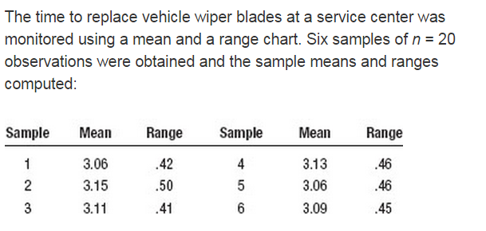
In Class Exercise:
  Determine upper and lower limits for mean(X-bar) and range charts.
  Is the process in control?
measurements

Slide 31
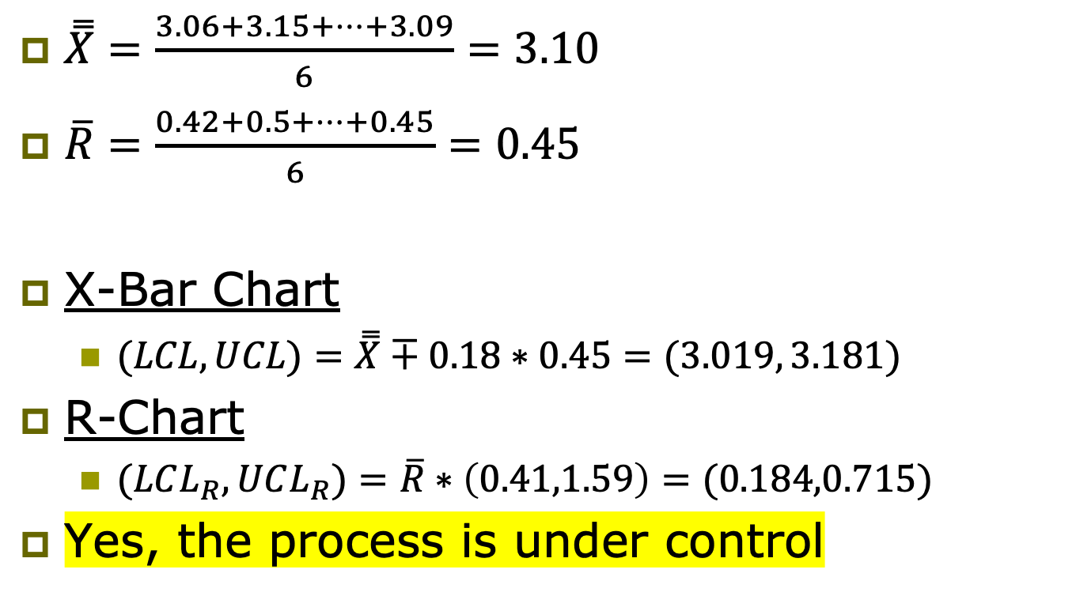
Solution
$\overset{̿}{X}=\frac{3.06+3.15+…+3.09}{6}=3.10$
$\overline{R}=\frac{0.42+0.5+…+0.45}{6}=0.45$
X-Bar Chart
  $(LCL,UCL)=\overset{̿}{X}∓0.18∗0.45=(3.019, 3.181)$
R-Chart
  $(LCL_{R}, UCL_{R})=\overline{R}∗\left(0.41,1.59\right)=(0.184,0.715)$
Yes, the process is under control

Slide 32
Process capability

Slide 33
A Common Measure of Process Capability
Equation
C_{p}=1 i.e. USL-LSL=6σ
upper specification limit
lower specification limit
Prob. Density
LSL
USL
process standard deviation
Cp > 1 : Process capable
Cp < 1 : Process not capable
Cp = 1 : Process borderline capable
Probability below LSL=0.135%
Disk Thickness
Probability above USL=0.135%
Probability of Defect = 0.27%
Notes:
Numerator: voice of the customer
Denominator: voice of the process
Don’t confuse USL/LSL with UCL/LCL
Cp increases -> lower defective rate
Cp = 1 -> 0.27% = 0.0027 = 2700 per 1,000,000

Slide 34
Are the Following Processes Capable?
Process | Sigma | USL | LSL | C_{p}
A1 | 0.05 | 100.03 | 99.97
A2 | 0.01 | 100.03 | 99.97
B1 | 0.001 | 5.05 | 4.95
B2 | 0.0005 | 5.05 | 4.95
B3 | 0.02 | 5.05 | 4.95

Slide 35
Are the Following Processes Capable?
Process | Sigma | USL | LSL | C_{p}
A1 | 0.05 | 100.03 | 99.97 | 0.2
A2 | 0.01 | 100.03 | 99.97 | 1.0
B1 | 0.001 | 5.05 | 4.95 | 16.67
B2 | 0.0005 | 5.05 | 4.95 | 33.33
B3 | 0.02 | 5.05 | 4.95 | 0.83

Slide 36
You Need to Be Careful With C_{p}
C_{p}=1 and Process Centered
C_{p}=1 but Process Mean increased by 1.5σ
Prob. Density
LSL
USL
Prob. Density
LSL
USL
Output
Output
Probability below LSL =normsdist(-3)=0.135%
Probability above USL =1-normsdist(3)=0.135%
Probability below LSL =normsdist(-4.5)=0.00034%
Probability above USL =1-normsdist(1.5)=6.68%
Probability of Defect = 0.27%
Probability of Defect = 6.68% !

Slide 37




Another common measure is C_{pk}
Process mean
Calculate the C_{p} and C_{pk} for Process A2 if the mean is 100
$$\text{USL}\text{,}\text{LSL}\text{,}σ\text{=100.03,99.97,0.01}$$
$$C_{pk}(μ=100)=1$$
Calculate the C_{p} and C_{pk} for Process A2 if the mean is 100.015
$$\text{USL}\text{,}\text{LSL}\text{,}σ\text{=100.03,99.97,0.01}$$
$C_{pk}\left(μ=100.015\right)=min⁡\{0.5,1.5\}$=0.5

